Slide 1
Foundations of Cryptography cryptography, confidentiality, integrity, authentication, non-repudiation, private-key encryption
LiangFeng Zhang
zhanglf@shanghaitech.edu.cn
SIST, ShanghaiTech, 2019F

Slide 2
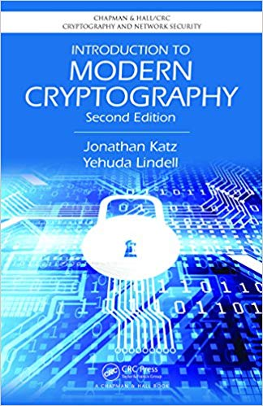
Course Information
Lectures: week 1-12? Office Hours: SIST 2-202.i, 8-9pm, Wednesday
Textbook: Introduction to Modern Cryptography (2nd edition)
Jonathan Katz and Yehuda Lindell, CRC Press, 2015.
https://www.amazon.com/Introduction-Cryptography-Chapman-Network-Security-ebook/dp/B00QFFY41K
Evaluation:
Attendance: 10%
Homework: 60%
Exam: 30%
Course Webpage: https://piazza.com/class/k09maz1xvcg3ee
textbook; lecture slides; questions and answers
Homework: https://www.gradescope.com/courses/62597
Entry Code: MKNW24

Slide 3
Information & Information System
Information: A measure of freedom of choice when one selects a
message; Information resolves uncertainty
“The mathematical theory of communication”
C. Shannon and W. Weaver, 1963
Information System: A discrete set of information resources organized
for the collection, processing, maintenance, use, sharing,
dissemination, or disposition of information.
Committee on National Security Systems Glossary (CNSSI-4009)
Computer Information System
Hardware, Software, Databases, Networks, Procedures

Slide 4
Information Security
DEFINITION: The protection of information and information systems
from unauthorized access, use, disclosure, disruption, modification,
or destruction in order to provide confidentiality, integrity, and
availability.
CNSSI-4009
Computer Security: Measures and controls that ensure confidentiality,
integrity, and availability of the information processed and stored
by a computer.
CNSSI-4009

Slide 5
Cryptography
The study of mathematical techniques for securing digital
information, systems, and distributed computations
against adversarial attacks
“Introduction to Modern Cryptography”, Katz, Lindell, 2015
The study of mathematical techniques related to aspects of information security such as confidentiality, data integrity, entity authentication, and data origin authentication
“Handbook of Applied Cryptography”, Menezes, van Oorschot, Vanstone, 1996
The discipline that embodies the principles, means, and
methods for the providing information security, including
confidentiality, data integrity, non-repudiation, and
authenticity.
CNSSI-4009

Slide 6


Confidentiality
“Transfer $1000 from Alice to David”
Alice
Bob (bank)
Charlie
adversary
The property that sensitive information is not disclosed to unauthorized individuals, entities, or processes.
FIPS 140-2

Slide 7
Integrity
“Transfer $1000 from Alice to David”
Alice
Bob (bank)
Charlie

Slide 8
Integrity
“Transfer $1000 from Alice to Charlie”
Alice
Bob (bank)
Charlie

Slide 9
Integrity
“Transfer $10000 from Alice to Charlie”
Alice
Bob (bank)
Charlie
The property that sensitive data has not been modified or deleted in an unauthorized and undetected manner.
FIPS 140-2

Slide 10
Authentication
“Transfer $1000 from Alice to Charlie”
Alice
Bob (bank)
Charlie
The process of establishing confidence in the identity of users or information systems.
SP 800-63

Slide 11
Non-Repudiation
“Transfer $1000 from Alice to David”
$$I never send this instruction‼!$$
Alice
Bob (bank)
$$I never receive this instruction‼!$$
Assurance that the sender of information is provided with proof of delivery and the recipient is provided with proof of the sender’s identity, so neither can later deny having processed the information.
CNSSI-4009; SP 800-60

Slide 12
Outline of the Course
Classical Cryptography: before 1980s
Historical Ciphers; One-Time Pad
Symmetric-Key Cryptography: share a secret key for security
Private-Key Encryption
Message Authentication Codes
Hash Functions
Practical Constructions
Asymmetric-Key Cryptography: do not share any secret key
Key Exchange
Public-Key Encryption
Digital Signature
Advanced Topics: the participants are adversarial
Secure Multiparty Computation

Slide 14
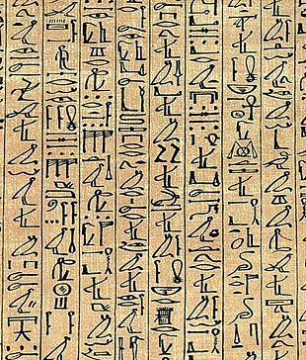
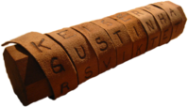
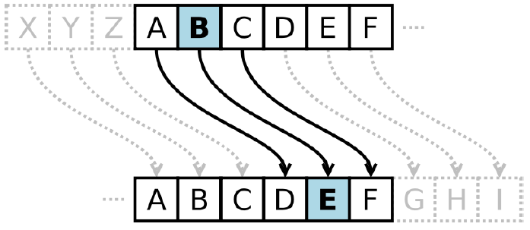
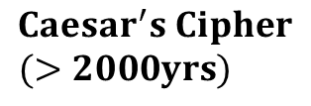
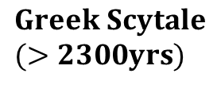
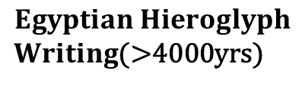
History of Encryption
$$Egyptian Hieroglyph$$
$Writing$(>4000yrs)
$$Greek Scytale$$
$(>2300yrs)$
$$Caesar^{′}s Cipher$$
$(>2000yrs)$

Slide 15
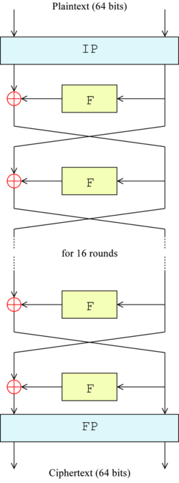
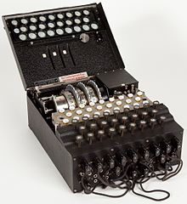
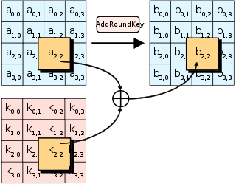
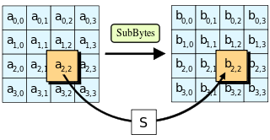
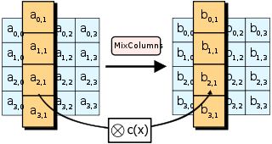
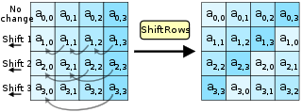



History of Encryption
$$Enigma$$
$$DES$$
$$AES$$

Slide 16
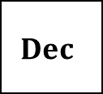


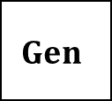

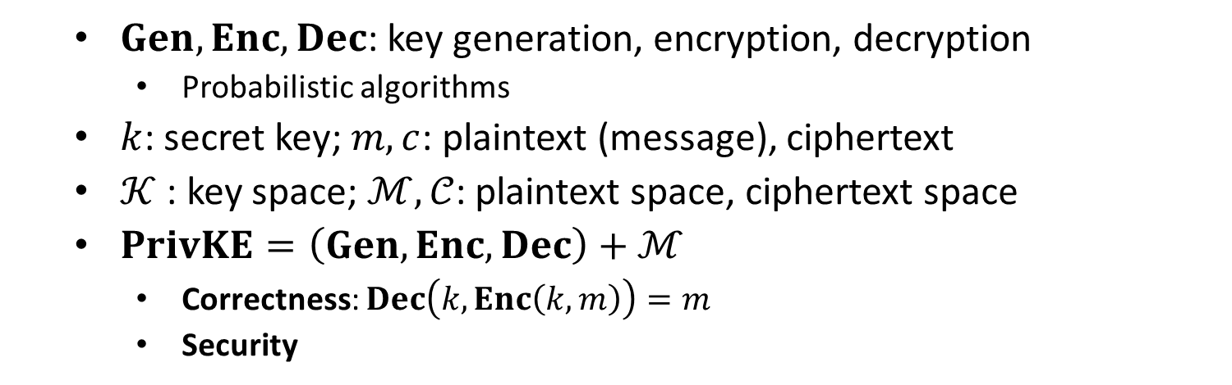
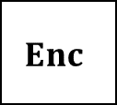


Private-Key Encryption
$$m$$
$$Enc$$
$$Enc(k, m)=c$$
$$Dec$$
Alice
Bob
$$k$$
$$k$$
$$Dec(k, c)=m$$
$$Gen$$
$Gen, Enc, Dec$: key generation, encryption, decryption
Probabilistic algorithms
$k$: secret key; $m, c$: plaintext (message), ciphertext
$𝒦$ : key space; $ℳ,𝒞$: plaintext space, ciphertext space
$PrivKE=\left(Gen, Enc, Dec\right)+ℳ$
Correctness: $Dec\left(k,Enc\left(k,m\right)\right)=m$
Security

